Slide 1
Green Chemistry and the ocean-based biorefinery
June 27, 2017

Slide 2
Biomass Utilization
Biomass - the matter that can be derived directly or indirectly from plant which is utilized as energy or materials in a substantial amount.
Virgin Biomass
Eucalyptus, hybrid poplar, palm tree, sugar cane, switch grass, kelp, algae
Waste Biomass
Agricultural wastes such as rice straw and rice husk
Forestry wastes such as sawdust and saw mill dust
Excrement, animal dung,
Kitchen garbage, sewage sludge

Slide 3
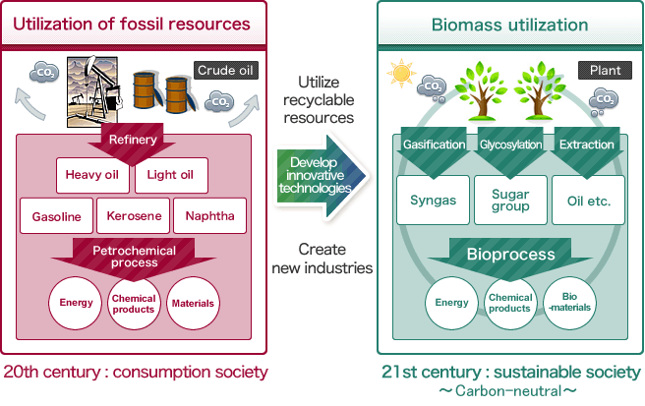
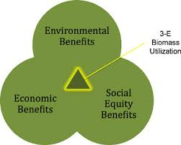
Why should we care?
Oil Depletion
Global Warming
Energy Security
Economic Benefits

Slide 4
Biomass Utilization - Energy
Biomass utilization for energy production through different technologies:
Direct Combustion
Gasification
Anaerobic Digestion
Methanol & Ethanol Production
Concern with land-based feedstock:
- Using food crops for fuels and chemicals
- Using arable land to grow fuel crops

Slide 5
Biomass Utilization – Forestry
Pulp and Paper
Bio-fuels (cellulosic ethanol)
High-value Bio-products

Slide 6
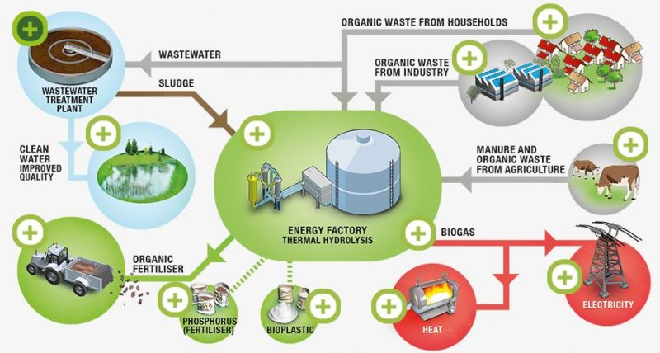
Biorefineries
Biorefinery - the sustainable processing of biomass into a spectrum of marketable products
and energy.

Slide 7
Current Existing Biorefineries
Blue Marble Energy – Small plant (2011), Large Plant (2013) - Montana
Hybrid bacterial groups to produce specialty biochemical and renewable biogas
Acid, Gas, and Ammonia Targeted Extraction (AGATE) method
Multiple types of organic biomass: food waste, yard waste, spent brewery grain, algae, milfoil, corn silage
Through anaerobic digestion and fermentation, the AGATE platform manipulates microbial environments to produce esters, amides, anhydrous ammonia, and rich biogas
Notes:
How does alage compare to other lan based crops for biofuel ease of extraction??

Slide 8
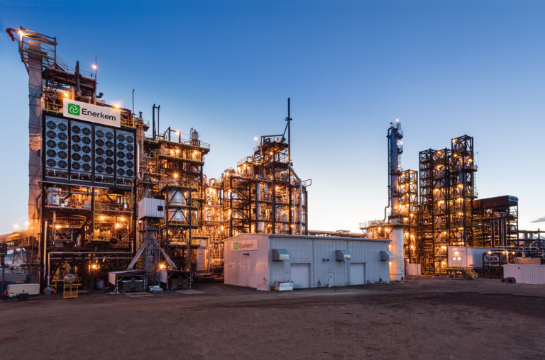
Current Existing Biorefineries
Enerkem Biorefinery – Hairy Hill, Alberta (2014)
Developed on anaerobic digestion technology
Utilizes Source Separated Organics from the metro Edmonton region, Open Pen Feedlot Manure, and Food Processing Waste
Products: Methanol and Ethanol

Slide 9
Feedstock comparison
Very complicated
1st Generation or 2nd Generation
Ethanol, Methanol or Butanol
Current technologies competing with new technologies
What is the purpose of your proses?
Fuel or chemicals or GHGs

Slide 10
Ocean
71% of the earth’s surface
Macro- and micro algae (seaweed)
Waste from fish farms
Shellfish => chitin and chitosan

Slide 11
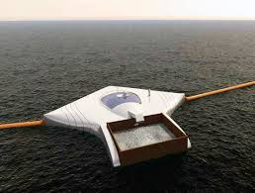
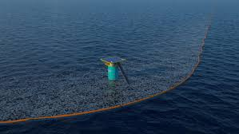
Clean-up Ocean Project

Slide 12
Advantages of Ocean-based Biorefineries
Notes:
Can spur economic activity in coastal cities with currently low trade
Can use supercritical fluids and water as solvent

Slide 13
Hurtles for Ocean-based Biorefineries
Notes:
What is chitosan used for??? Biomedical field??
Valorization of fish waste greater challenge than algal crops
Sanitation
Already used to make chitosan and glucosamine sulfate

Slide 14
Questions:
How do people feel about using our oceans as a source of fuel and chemicals instead of our land?
Do you think using the oceans for these products would be more sustainable than land?
How could humans prevent misuse of the ocean? Ecosystem disruption? Have we/what have we learned from the over use of our land?
Would using ocean’s in this way bring more awareness to ocean pollution?
How do you think the public would respond to getting fuel and chemicals from waste?
Currently, there is a knowledge hole with implementing ocean-based bio refinery. Who should give the research funding?

